Slide 1
DATA ANALYST PORTFOLIO PROJECT
BANK LOAN ANALYSIS

Slide 2
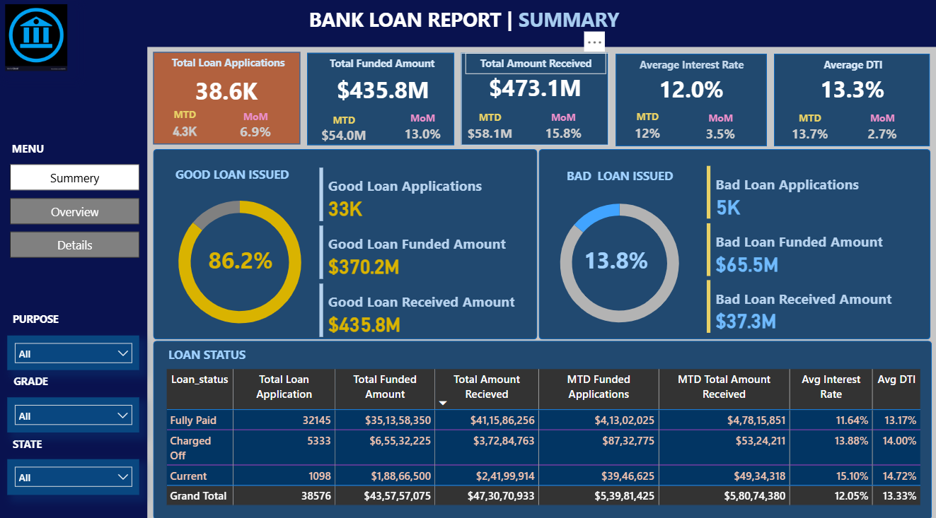

Slide 3
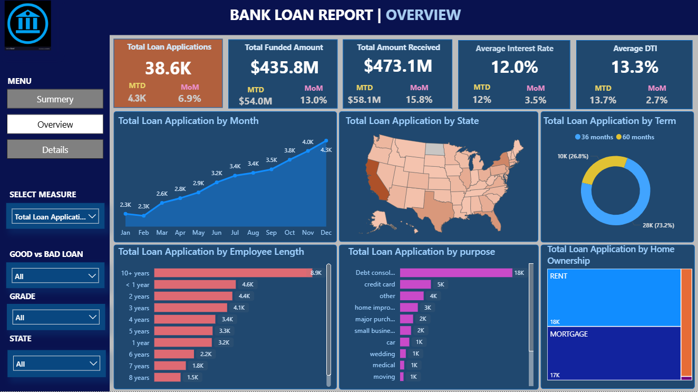

Slide 4
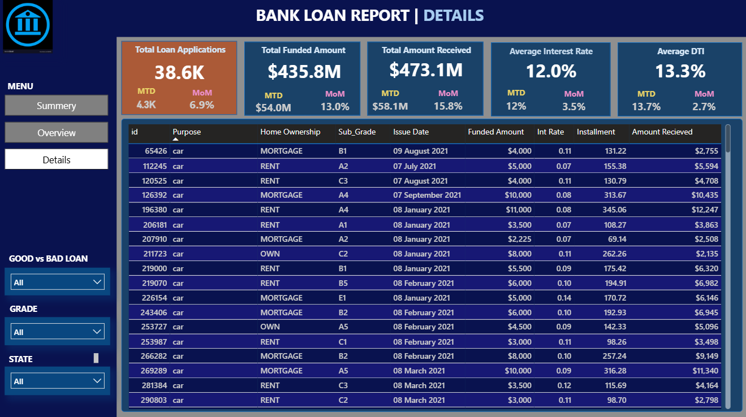

Slide 5
PROBLEM STATEMENT :
DASHBOARD 1: SUMMARY
Key Performance Indicators (KPIs) Requirements:
1. Total Loan Applications Track the overall number of loan applications received within a specific time frame. Additionally, monitor the Month-to- Date (MTD) loan applications and analyze Month-over-Month (MoM) trends to identify changes in application volume.
2. Total Funded Amount Measure the total value of loans disbursed to borrowers. This includes tracking the MTD funded amount and evaluating MoM changes to understand fluctuations in loan disbursement activity.
3. Total Amount Received Monitor the total repayment amount collected from borrowers. Analyze the MTD received amount and assess MoM variations to evaluate loan recovery performance and cash flow trends.
4. Average Interest Rate Calculate the average interest rate applied across all loans. Include MTD averages and assess MoM changes to gain insights into the lending portfolio's pricing and rate movement.
5. Average Debt-to-Income (DTI) Ratio Evaluate the financial health of borrowers by calculating the average DTI ratio. Report both overall and MTD averages, and analyze MoM trends to detect changes in borrower risk profiles over time.

Slide 6
Good Loan v Bad Loan KPI’s
Good Loan:
Good Loan Application Percentage
Good Loan Applications
Good Loan Funded Amount
Good Loan Total Received Amount
Bad Loan
Bad Loan Application Percentage
Bad Loan Applications
Bad Loan Funded Amount
Bad Loan Total Received Amount
Loan Status Grid View
In order to gain a comprehensive overview of our lending operations and monitor the performance of loans, we aim to create a grid view report categorized by 'Loan Status.’ By providing insights into metrics such as 'Total Loan Applications,' 'Total Funded Amount,' 'Total Amount Received,' 'Month-to-Date (MTD) Funded Amount,' 'MTD Amount Received,' 'Average Interest Rate,' and 'Average Debt-to-Income Ratio (DTI),' this grid view will empower us to make data-driven decisions and assess the health of our loan portfolio.

Slide 7
DASHBOARD 2: OVERVIEW
1. Line Chart – Monthly Trends Shows loan activity over time to detect seasonality and long-term trends.
2. Filled Map – Regional Analysis Highlights lending volume by state to identify regional disparities.
3. Donut Chart – Loan Term Distribution Visualizes how loans are spread across different repayment terms.
4. Bar Chart – Employment Length Analyzes loan metrics by borrower employment history.
5. Bar Chart – Loan Purpose Breaks down loans by purpose (e.g., credit card, home improvement).
6. Tree Map – Home Ownership Shows how home ownership type impacts loan applications and funding.
Metrics to be shown: 'Total Loan Applications,' 'Total Funded Amount,' and 'Total Amount Received'

Slide 8
DASHBOARD 3: DETAILS
Purpose: A consolidated grid view to present all key loan data in one place.
Objective: To provide users with an intuitive, all-in-one interface for accessing detailed insights into loan metrics, borrower profiles, and portfolio performance efficiently.

